Slide 1
Assessment of a Risk-based quality management approach to protocol deviations A Data Coordinating Center’s Experience
Marie T. Kay, BA, Nael Abdelsamad, MD, MBA,
Shelly Roalstad, MSc, Jordan Bridges, BS, and Bradley J. Barney, PhD
University of Utah - Clinical Research Enterprise
Notes:
*Introduction
Thank you for the opportunity to present.
My name is Marie Kay - I am speaking on behalf of our 4 co-authors listed here.
I work with the UT TIC and DCC at the UofU.
We extensive experience managing multicenter studies and working with large research networks for over 20 years.
As a member of our quality group, we develop and test innovative, risk-based quality approaches for managing studies –hence the topic you will hear more about shortly.

Slide 2
disclosures
Marie T. Kay – No Disclosures
Nael Abdelsamad – No Disclosures
Shelly Roalstad – No Disclosures
Jordan Bridges – No Disclosures
Bradley Barney – No Disclosures
Notes:
All co-authors have nothing to disclose regarding this presentation.

Slide 3
BACKGROUND

Slide 4
Protocol DEVIATION Definition
A deviation is ANY departure from the defined procedures and treatment plans as outlined in the protocol…submitted and previously approved by the Institutional Review Board.
PD = protocol deviation
Source: Deviations - IRB - The University of Utah
Notes:
Many definitions, interpretations, and categorizations of deviations exist.
For the purpose of this presentation we use a BROAD definition and define as ANY…[read slide]
I will also use the acronym PD for protocol deviation throughout the slides.

Slide 5
managing PDs is an important aspect of clinical trial conduct and quality
PDs can significantly impact human subject protections and reliability of trial results
adequate management is vital to mitigating and controlling the impact
Notes:
An important aspect of clinical trial conduct and quality is the management of PDs.
They represent issues of noncompliance and can significantly impact HSP and ROTR.
Thus, adequate management of PDs is vital to mitigating and controlling their impact on our research.
With respect to the theme of this year’s meeting, we know that research can influence public health policymaking, so it’s important that we can stand by the quality, reliability, and integrity of the data we produce.

Slide 6
ICH E6(R2) GCP
Efficiency
Focus on relevant activities
Risk-based quality management
Industry applying more
risk-based approaches
Notes:
In 2016, the ICH Good Clinical Practice Guidelines were amended. They now…
-encourage more efficient approaches to planning and executing research,
-they advise focusing on relevant activities that ensure HSP and ROTR.
-and they promote using a RB approach to QM.
(CLICK) In response, we are seeing the industry increasingly apply more RB approaches.
The CAVEAT is that it’s still a relatively new concept to our industry and it can be challenging to introduce and integrate new approaches with our partners and collaborators when we are all still “testing the waters”, changing our standard processes, and figuring out best practices.

Slide 7
ALL
Protocol
Deviations
SIGNIFICANT
Protocol Deviations
Notes:
So, our Center aimed to improve efficiencies by developing a RB approach to PD management.
In the past, we have instructed sites to report ALL PDs to our Center. (GREY CIRCLE)
This requires a lot of effort for our sites AND for our internal team to review and manage that data.
Ultimately, this approach lacks efficiency and value b/c most deviations sites report to us have no significant impact to the study results or participants.
So, we developed a RB approach (CLICK) where we instruct sites to only report more significant types of deviations to our Data Center.

Slide 8
Risk-Based REPORTING Criteria
Has a significant/potentially significant impact to human subject protections or reliability of trial results, and/or
Intended to eliminate apparent immediate hazard to participant, and/or
Resulted in an unanticipated problem with significant/potentially significant impact to human subject protection or reliability of trial results
Notes:
Specifically, sites are instructed to report the deviation to us if it meets ANY of the 3 RB criteria you see here:
READ THROUGH

Slide 9
AIM

Slide 10
To assess whether our risk-based approach to reporting PDs ensures human subject protections and reliability of trial results
Notes:
Our aim was to assess whether or not our approach ensures HSP and ROR, w/o compromising quality.
[Note: This image is from Pixabay. License notes it is free for commercial use; no attribution required.
https://pixabay.com/vectors/checklist-evaluation-selection-443126/]

Slide 11
METHODS
Notes:
We had a recent trial that created an opportunity to assess our approach.

Slide 12
ALL PDs recorded in the database and graded as follows:
Grade 1: No impact on data quality or patient safety
Grade 2: Minor impact on data quality
Grade 3: Minor impact on patient safety
Grade 4: Major impact on data quality or patient safety
Grade 5: Leading to patient death
Grade 4 and 5 PDs were further assessed to determine if they met any of the risk-based criteria
Notes:
In this study, sites were asked to:
record and report ALL PDs in the study database (our EDC),
assess impact using the 5 point scale you see here
determine if the grade 4 or grade 5 PDs met any of our RB reporting criteria
[Note if asked: this scale was a standard from another institute we partnered with, which reflects their standard process for managing PDs)

Slide 13
2 raters assessed the PDs using same criteria as the sites
Ratings were compared:
between the 2 raters, and
to what sites reported in the EDC
Inter-rater agreement measured by percent agreement and kappa
Notes:
Next, we asked 2 raters, independent from the study, with a background in project management to assess the deviations using the same criteria as the sites
Ratings were compared (READ BULLET 2)…
To measure inter-rater agreement, we used both percent agreement and kappa.
For those of who have less of a Stats background (like myself), Kappa assesses chance-corrected agreement.
Values near 0 suggest agreement similar to what is observed by chance assignment,
While values near 1 indicate higher agreement between raters far beyond what would be observed by chance.

Slide 14
RESULTS

Slide 15
91 Protocol Deviations of 6 types
Type | N
Consent process | 39
Randomization/stratification | 38
Study procedure completed out of window | 7
Unblinding | 4
Breach of confidentiality | 2
Data from wrong (unconsented) individual | 1
Notes:
Although there were 91 deviations captured in the database, they represented relatively few distinct types.
The main analysis used these 6 types, keeping only one PD per type to avoid artificial inflation of the effective sample size.
Two types of PDs were very common. As such, the exploratory analyses that regarded all 91 PDs as though they were statistically independent are heavily influenced by the agreements in those two types and must be interpreted cautiously.
[In case asked: In the original abstract, analysis had used 7 types and not necessarily the same instance of each type. Results are now somewhat different for the main analysis.]

Slide 16
Estimated Agreement in grades
 |  | N=6 Types |  | N=91 PDs
Characteristic | Reviewer Comparison | Kappa | % Agree-ment | Kappa | % Agree-ment
Grade: 1-5 | R1 vs. R2 | 0.14 | 50% | 0.05 | 14%
 | R1 vs. EDC | 0.29 | 67% | 0.15 | 56%
 | R2 vs. EDC | -0.31 | 33% | -0.45 | 12%
Grade Dichotomized: 1-3 vs. 4-5 | R1 vs. R2 | 0 | 83% | 0 | 58%
 | R1 vs. EDC | 0 | 83% | 0 | 58%
 | R2 vs. EDC | n.e. | 100% | n.e. | 100%
n.e. = not estimable
Generally poor chance-corrected agreement
Notes:
First, we review agreement in the grades assigned to the PDs. We examined both the 1-5 scoring and whether the grade was indicative of a major impact as identified by grades of 4 or 5.
From the bottom middle of this table [CLICK 1], we see the % agreement was very good for the dichotomized grade determination when each type of deviation was only counted once. However, [CLICK 2] this is the only situation with very good % agreement between all reviewer comparisons . The original grade categories exhibited modest % agreement.
Not only are the % agreements often modest, but the kappa estimates [CLICK 3] suggest generally poor chance-corrected agreement.
Confidence intervals were also estimated for the kappas where possible, but generally were not useful due to extreme widths.
[If asked: kappa was not estimable in situations where the two-way table for a given pair of reviewers had only one nonzero cell: i.e., only of the possible responses was ever observed among the pair of reviewers.]

Slide 17
Estimated Agreement in criteria
 |  | N=6 Types |  | N=91 PDs
Characteristic | Reviewer Comparison | Kappa | % Agree-ment | Kappa | % Agree-ment
Significant impact on participants/ study results | R1 vs. R2 | 0 | 83% | 0 | 58%
 | R1 vs. R3 | 0 | 83% | 0 | 58%
 | R2 vs. R3 | n.e. | 100% | n.e. | 100%
To eliminate hazard | Every pair | n.e. | 100% | n.e. | 100%
Resulted in unanticipated problem | R1 vs. R2 | 0 | 83% | 0 | 98%
 | R1 vs. R3 | n.e. | 100% | n.e. | 100%
 | R2 vs. R3 | 0 | 83% | 0 | 98%
n.e. = not estimable
Notes:
For each of the RB criteria our Center uses, (CLICK 1) the percent agreement tended to be very good, with the notable exception that because of a disagreement in one of the 6 types that repeated many times, the estimates in the upper right portion (CLICK 2) of the table indicate inadequate agreement.
However, chance-corrected agreement, as estimated by kappa, was uniformly very poor when estimable.

Slide 18
DISCUSSION

Slide 19
Limitations
Data from one study
Few unique PD types, with subjective assignment of types
Raters external to study team; limited familiarity
Notes:
We recognize a few limitations:
Our data came from a single study…
with relatively few unique types of deviations.
The limited sample size fostered highly variable estimates, particularly for kappa.
And, while we intentionally chose to compare the data entered by sites in the EDC to that from independent raters, our raters had limited familiarity with the intricacies of the study.

Slide 20
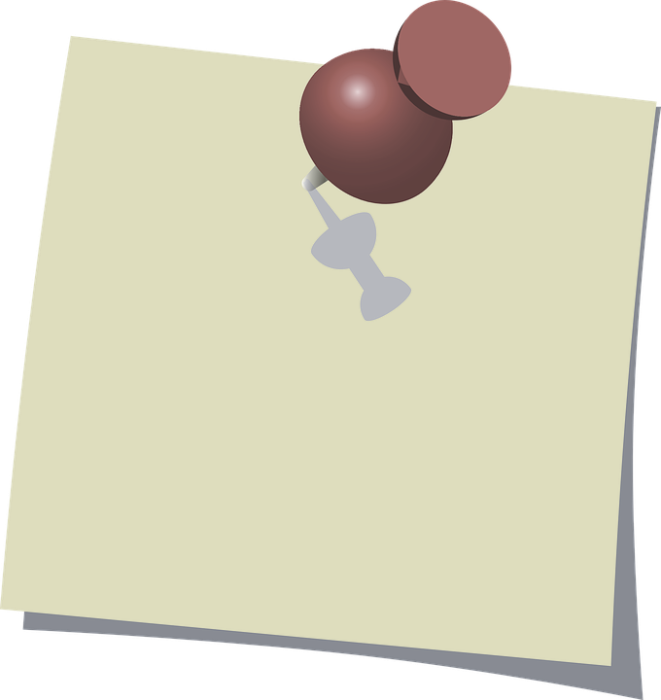
MAIN Takeaway
Risk-based approach may have
missed 2 important PD types:
inconsistency between raters
continued non-compliance not captured
designed to capture single issues vs. in aggregate
BUT…identified through other monitoring methods
Notes:
Our main takeaway is that:
Our RB approach may have missed 2 important types of deviations’ due to:
Inconsistency b/w raters, as our estimates suggest. Subjectivity exists with an approach like this (e.g., one person might say a deviation is significant whereas another might not).
Our approach doesn’t directly capture continued non-compliance b/c it was designed to capture single issues (vs in aggregate). There was a type of deviation, when viewed as a single instance not be deemed significant, but potentially considered significant.
However, what’s interesting is that this particular issue was identified through other monitoring methods (so, ultimately, it wasn’t missed).
[Note: This image is from Pixabay. License notes it is free for commercial use; no attribution required: Note Reminder Paper - Free vector graphic on Pixabay]

Slide 21
FUTURE CONSIDERATIONS
incorporate better training for anyone assessing PDs to minimize inconsistency
consider if/how we might want to capture continued noncompliance
Notes:
So, our future considerations regarding improving our RB approach would be to :
incorporate better training for anyone assessing PDs to minimize inconsistency
2. consider how to capture continued noncompliance as part of our RB criteria, especially if it is not anticipated to be captured through other monitoring methods
In summary, this has helped us identify some of the caveats and improvement opportunities to our approach, which is valuable as we continue to fit together the building blocks of integrated risk-based QM.
[Note: This image is from Pixabay. License notes it is free for commercial use; no attribution required: Think Hand Reflect - Free image on Pixabay]

Slide 22
Q & A

Slide 23
disclosures
Marie T. Kay – No Disclosures
Nael Abdelsamad – No Disclosures
Shelly Roalstad – No Disclosures
Jordan Bridges – No Disclosures
Bradley Barney – No Disclosures

Slide 24
EXTRA SLIDES

Slide 25
